Slide 1

GodSend
Crowdsourcing Heros

Slide 2
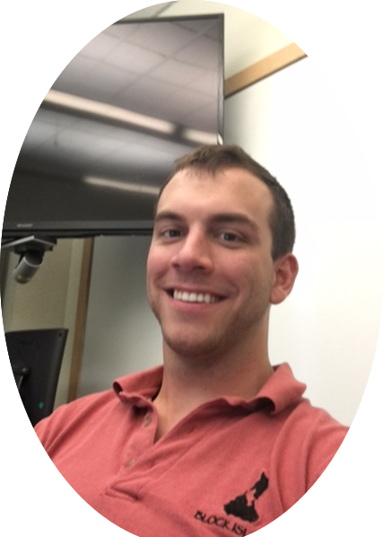
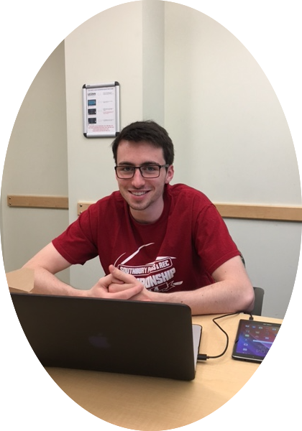

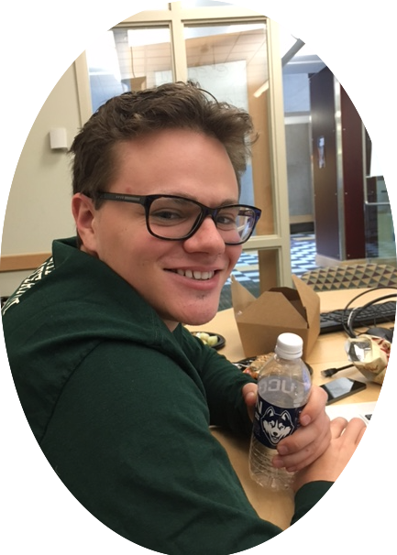
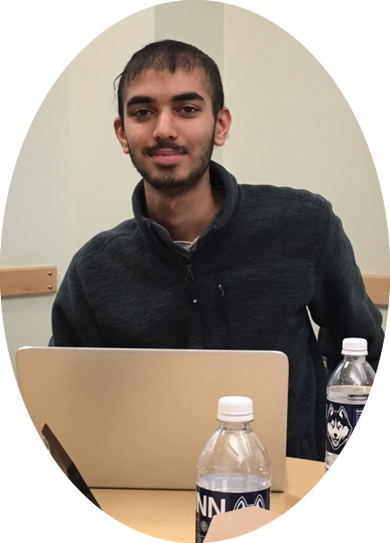
Diverse Team
Charles Fayal
Entrepreneur
Electrical/Biomedical Engineer
Mike Wynne
Innovator
Computer Science Engineer
Arun George
Visionary
Computer Science Engineer
Rich Conner
Marketer and Business Dev.
Finance
Avi Patel
Healthcare Specialist
Molecular Cellular Biology/ Pre-Med

Slide 3
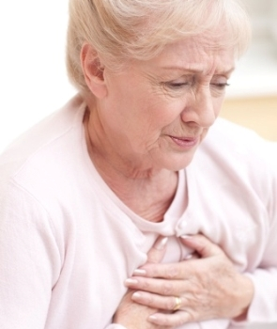
The Inspiration

Slide 4



Facts and Statistics
Takes less than 10 minutes for somebody to choke
2,500 easily preventable choking deaths a year
Take up to 18 minutes for EMS response time
Currently, no system to notify people nearby who could help!
Notes:
Choking
heart attacks
Bleeding out

Slide 5
Current Technology
Systems Used
Off duty dispatch systems for Government employees
Hospital alert systems for alerting doctors/nurses
Problems
Diversity of systems with a lack of overlap
Locally based
Lack geographically specification

Slide 6




GodSend
Crowdsourcing
Connectivity
Lightning fast response times
Lives Saved

Slide 7
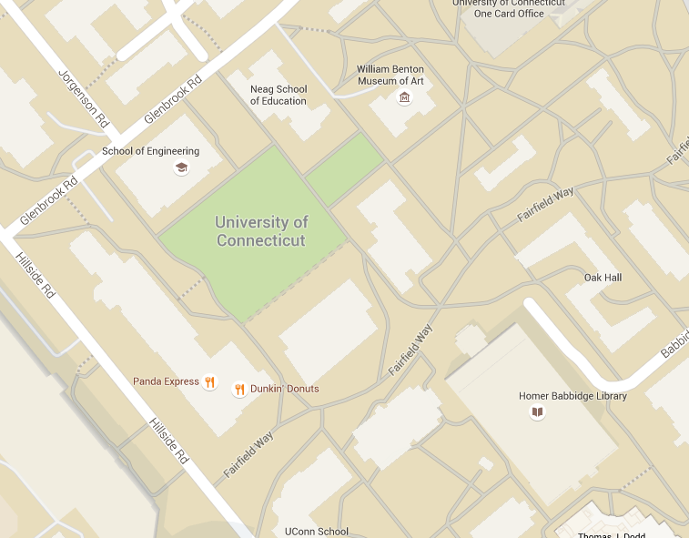
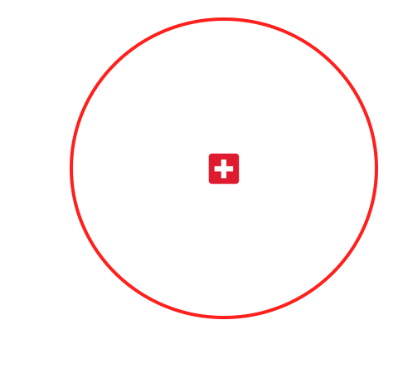
How does it work?
Steps
Emergency occurs
Dispatch reports an emergency
GodSend finds nearby people
Notifies them of the event
They can choose to respond
Lives Saved
Heart attack

Slide 8
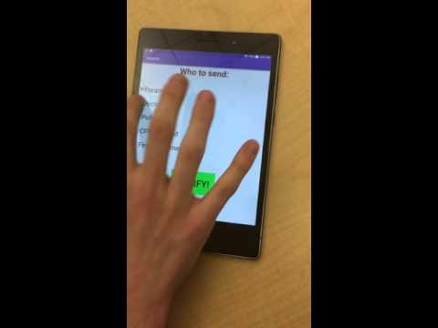
Demonstration

Slide 9
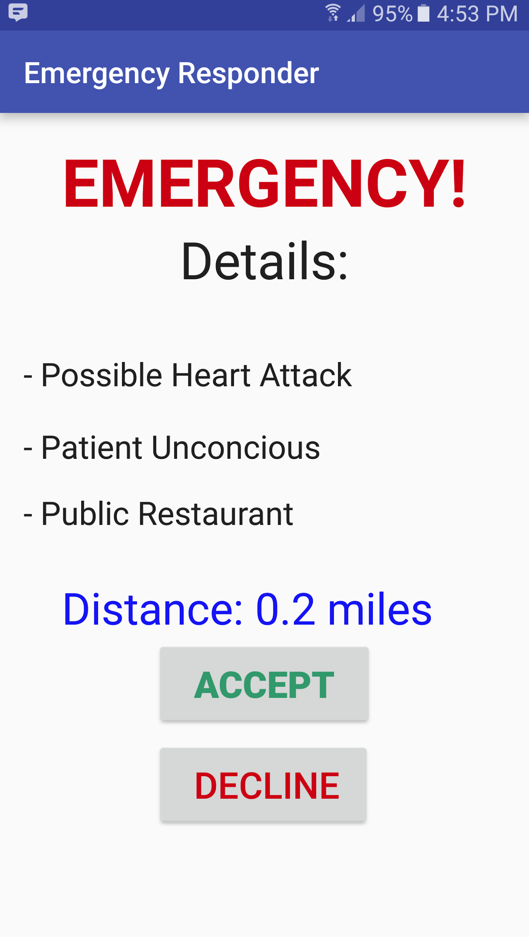
Design
Inexpensive and easy software to build
Uses smartphones GPS capabilities
Features
  Alerts depending on location
  Alerts people who specifically have the ability to help
  Across the nation instead of county specific
  User Specifications

Slide 10


Incentives for responders?
Who doesn’t want to be a superhero and save lives?!
Good Samaritan laws prevent liability

Slide 11
Market Research
Contacted
  Multiple police departments from UCPD to NYPD
  Healthcare Workers
  Firemen
  Doctors
Nothing in place with the coverage or capabilities that GodSend will have
People were interested and liked the idea
“If I could help at an emergency going on around me, I would love to be notified”
Patrick Gill, Fireman, Stamford Fire Department

Slide 12
Thank You!
Help us create God Sends and save lives!

